Slide 1
Usability goals
Effective to use
Efficient to use
Safe to use
Have good utility
Easy to learn
Easy to remember how to use

Slide 2
User experience goals
  Satisfying - rewarding
  Fun - support creativity
  Enjoyable - emotionally fulfilling
  Entertaining …and more
  Helpful
  Motivating
  Aesthetically pleasing
  Motivating

Slide 3
Usability and user experience goals
How do usability goals differ from user experience goals?
Are there trade-offs between the two kinds of goals?
  e.g. can a product be both fun and safe?
How easy is it to measure usability versus user experience goals?

Slide 5


Which are universal and which are culturally-specific?

Slide 7
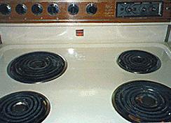
Activity on mappings
  Which controls go with which rings (burners)?
A
B
C
D

Slide 8

Why is this a better design?

Slide 10

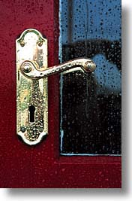
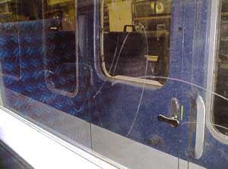

Activity
  Physical affordances:
    How do the following physical objects afford? Are they obvious?

Slide 11
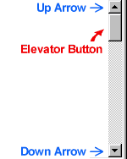


Activity
  Virtual affordances
    How do the following screen objects afford?
    What if you were a novice user?
    Would you know what to do with them?

Slide 13
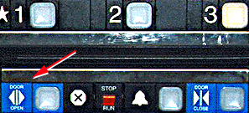
Example of bad and good design
  Elevator controls and labels on the bottom row all look the same, so it is easy to push a label by mistake instead of a control button
  People do not make same mistake for the labels and buttons on the top row. Why not?
From: www.baddesigns.com

Slide 14
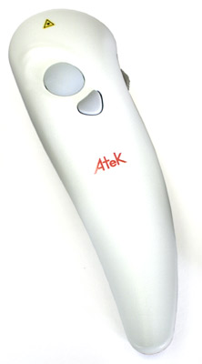
Good design or bad design?
Atek Tote-Remote 100, for example see http://www.bits.com/I-software/10128125.html

Slide 15
